Slide 1
Bushfire Classification using CNN’s
Option: 2 Abdulaziz El Sabbagh 24572378
Introduce problem → dive into CNN’s → challenges → go to code

Slide 2
Why Bushfires?
Relevant to my honours project which will be conducted next year
Increasing severity and frequency due to climate change
Black summer 2019-2020
Existing methods have limitations in accurately and swiftly detecting and classifying bushfires, making it a critical problem to address.

Slide 3

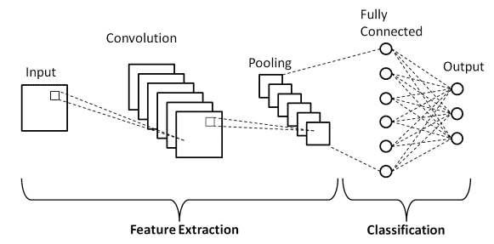
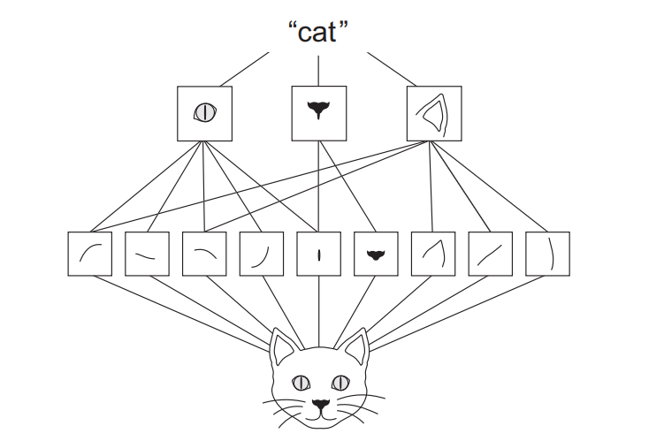
What are CNN’s
Specialised for visual Data
Layered architecture
Superior Image Classification
Excellent spatial hierarchy

Slide 4

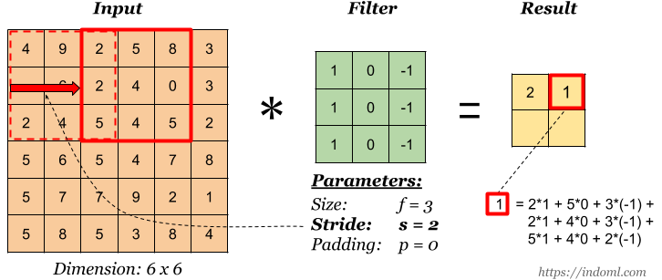
Convolution Layers

Slide 5
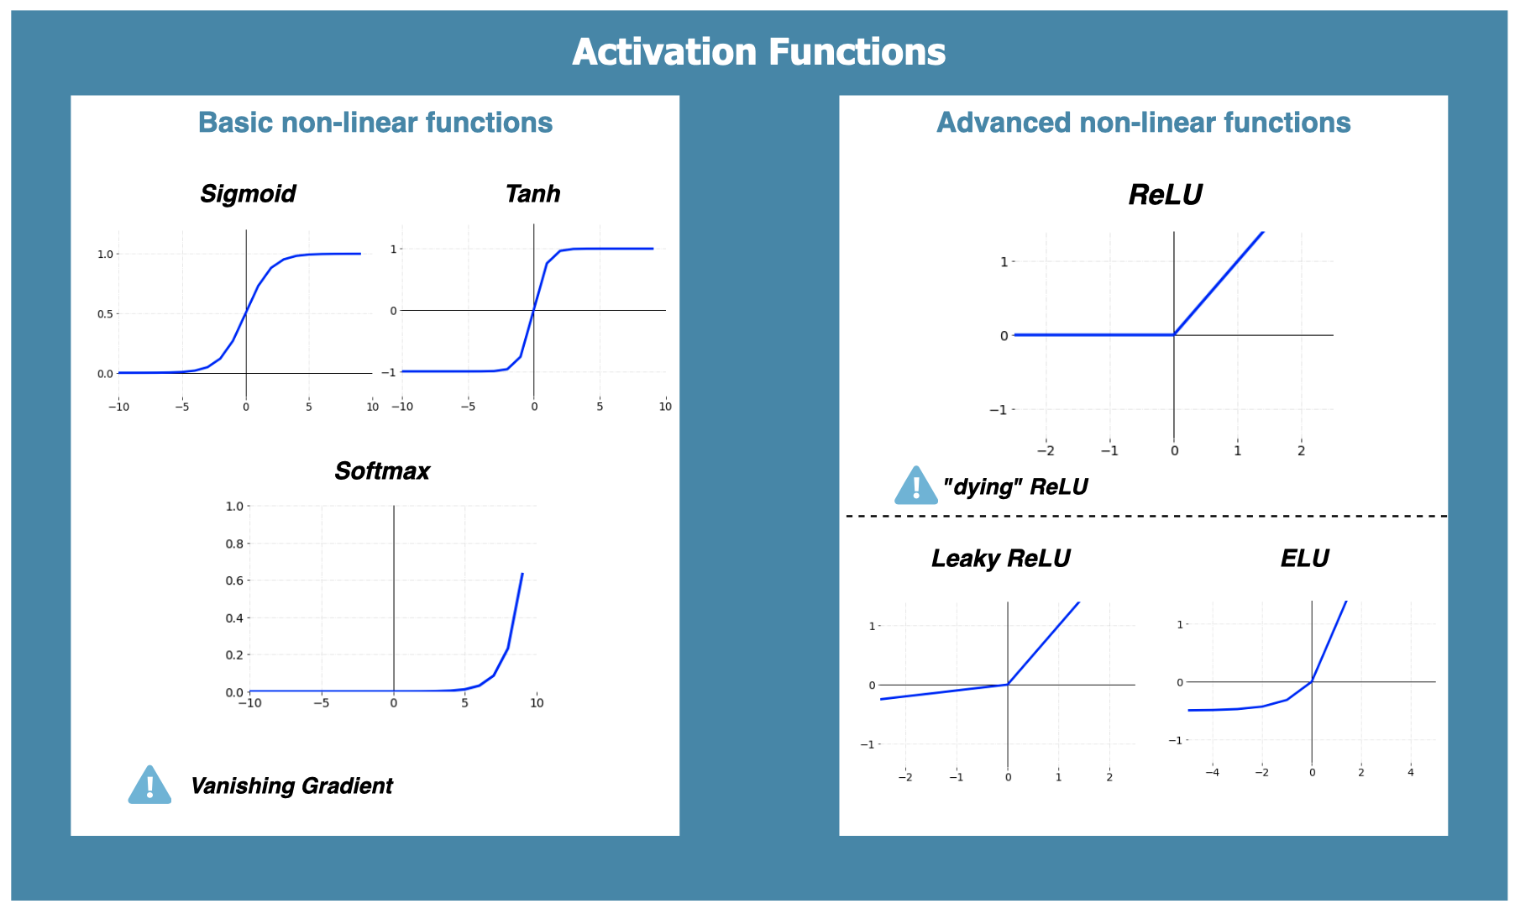

Activation Functions

Slide 6
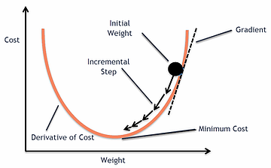
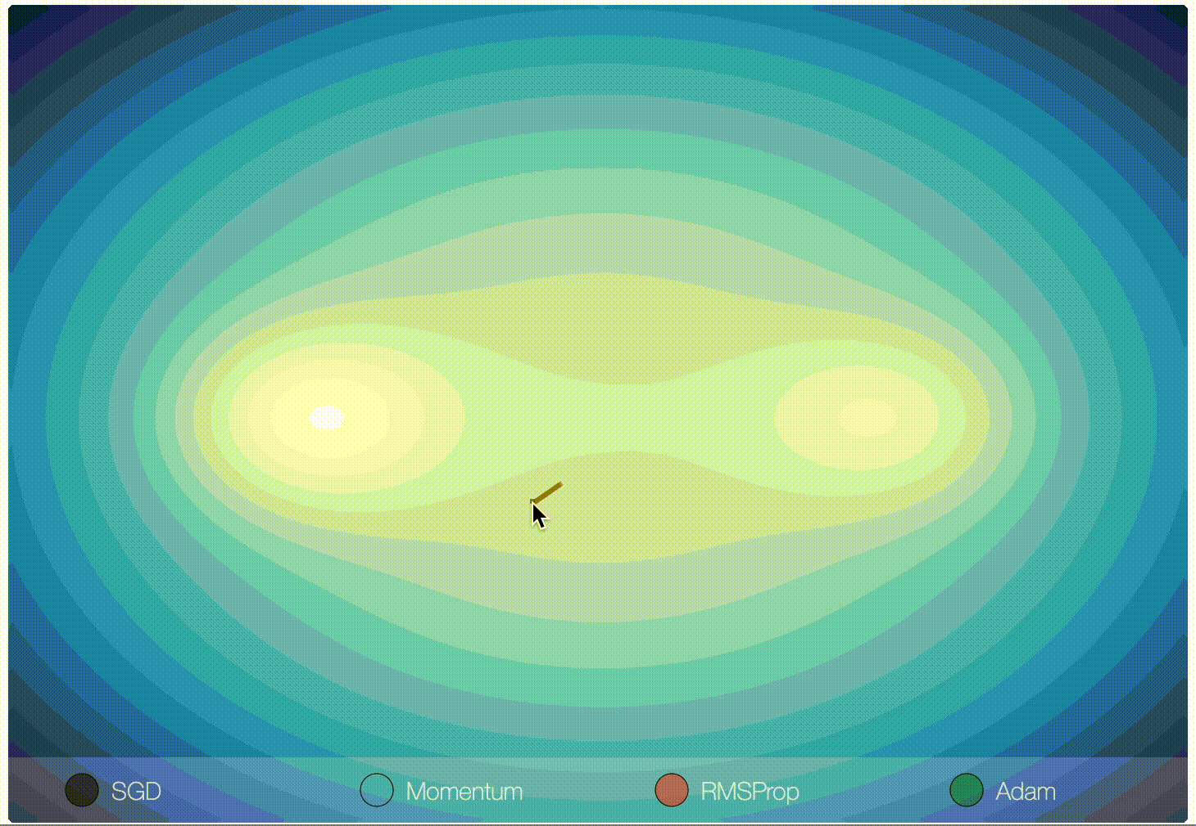
Optimisers
SGD (Stochastic Gradient Descent)
RMSprop (Root Mean Square Propagation)
Adam (Adaptive Moment Estimation)

Slide 7
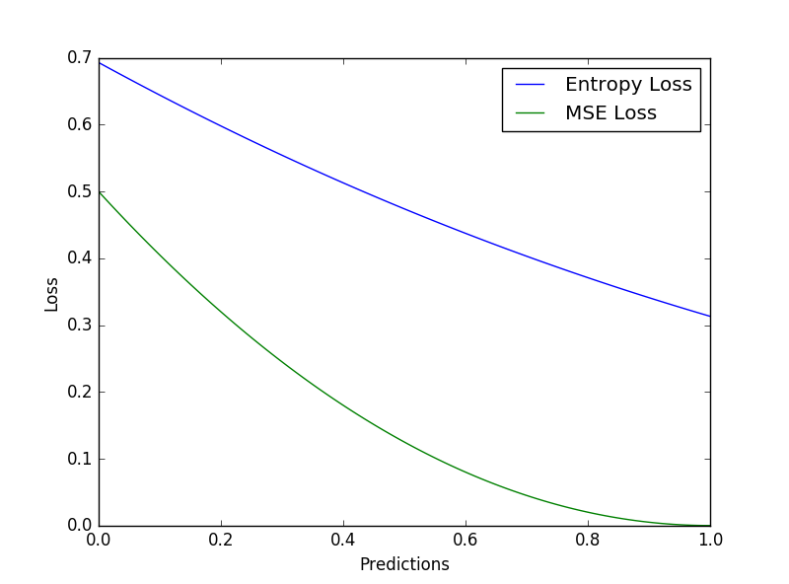
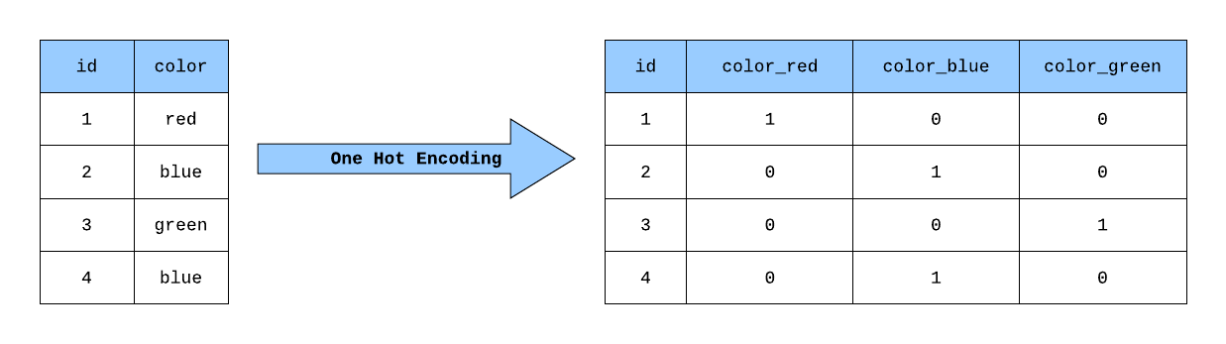
Loss

Slide 8
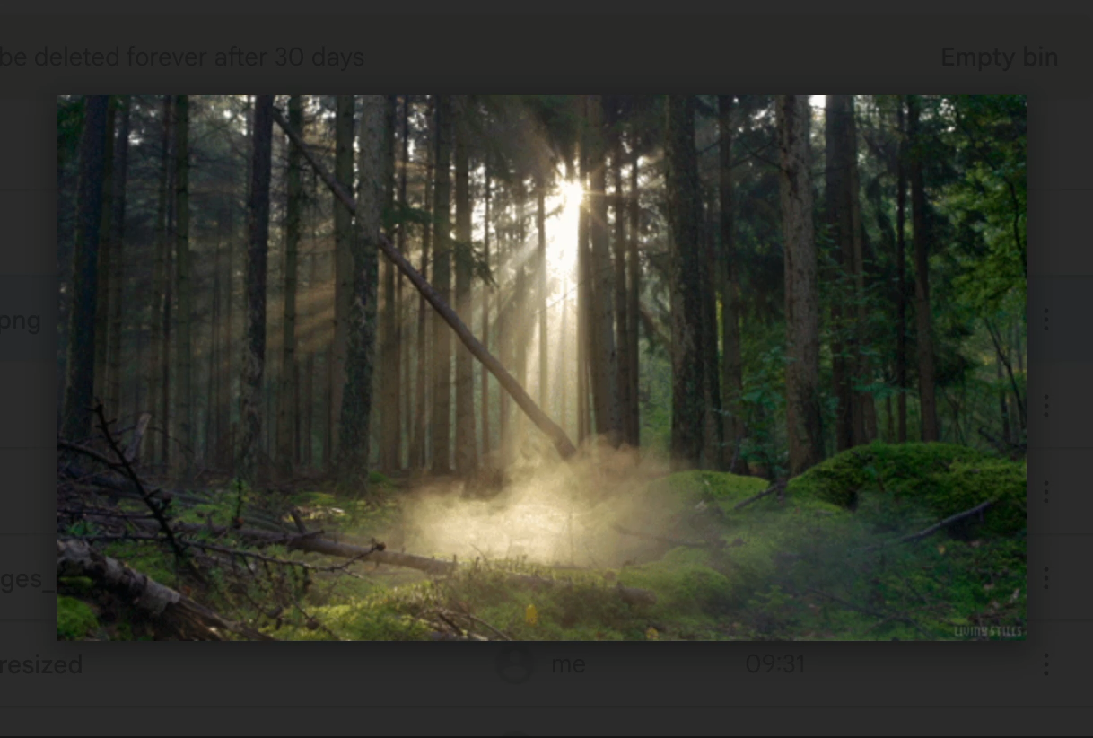
Challenges and insights
high false positive rate
Incompatible loss function/ activation function
Incompatable images in the dataset

Slide 9
Lets look at the code

